Slide 1
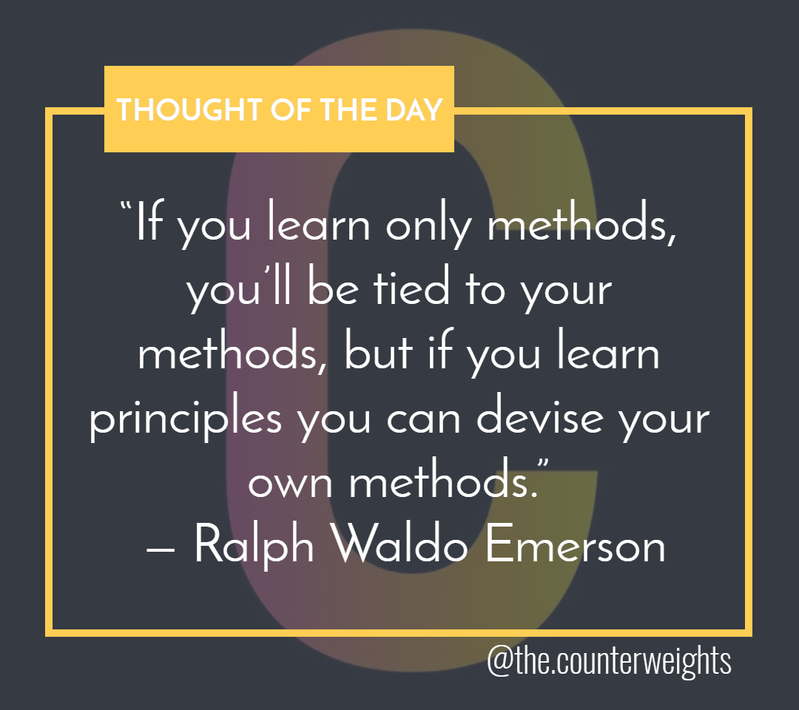

Slide 2




Underlying Principles of design
Makes elements different to increase understanding and create distinction.
Repeat visual elements to create sense of unity.
It’s the way elements relate to each other on a page or in space. All elements should have a visual connection.
Place related items together to convey relationships.

Slide 3

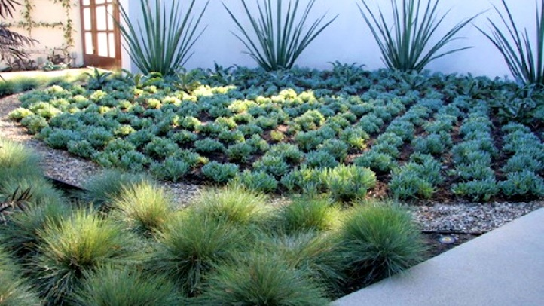

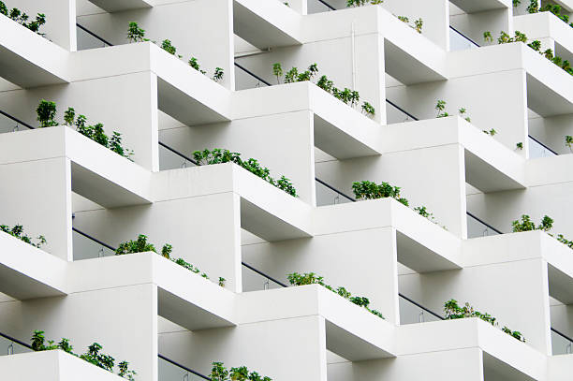
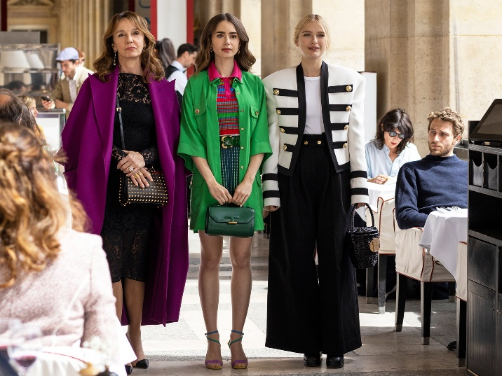
Universal Application
for Design Principles
Landscape architecture
Package design
Architecture
Fashion

Slide 4
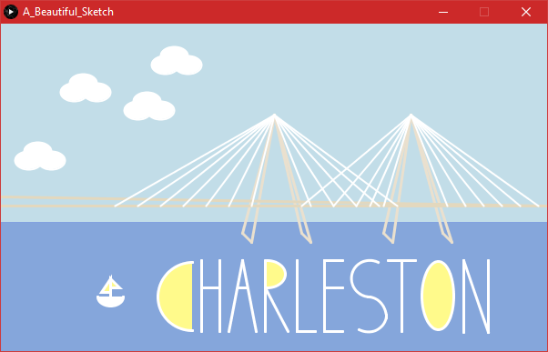

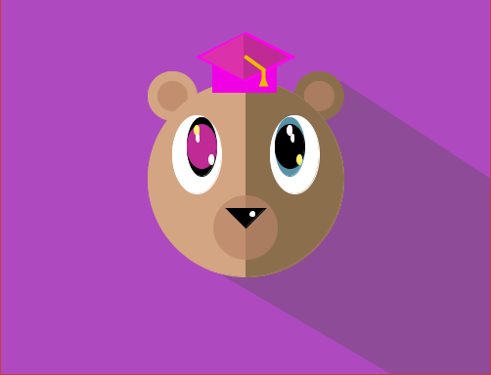
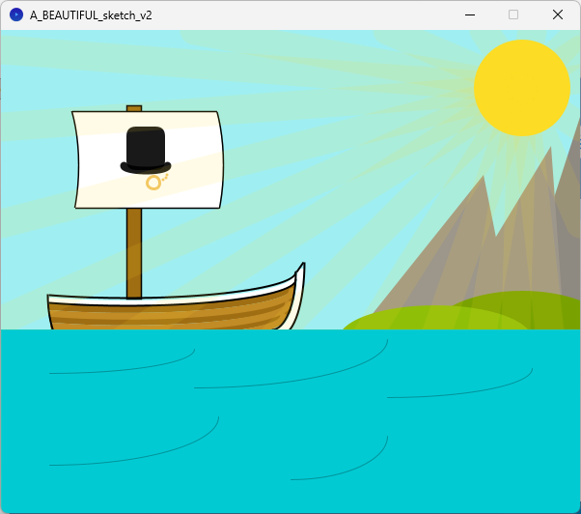
Exemplifying Principles with Processing Programming
Annie F.
Amber L.
Morgan G.
Robert R.

Slide 5
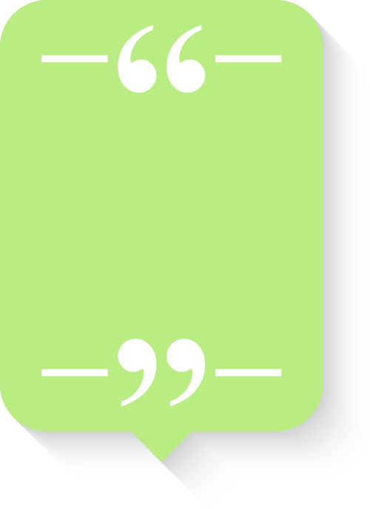
Popular uses
The idea behind contrast is to avoid elements on the page that are merely similar. If the elements [...] are not the same, then make them very different.
~ Robin Williams
Sizes of objects and text
Shape variations
Color differences
Texture
Thick/thin lines
…anything that distinguishes
In other words, “Don’t be a wimp – do it with strength.”

Slide 6
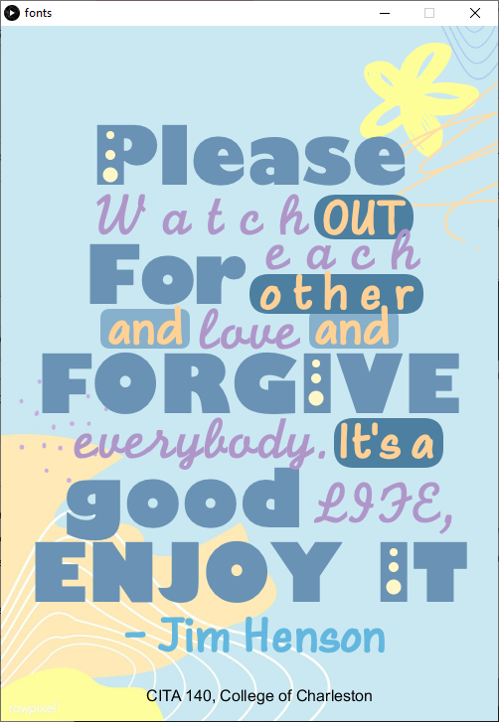
Distinction by size, color scheme, and typeface
Notes:
The idea of “very different” is just one school of thought. On the other hand, you can sometimes use slight contrasts, such as use of Arial & Arial Narrow.

Slide 7


Contrasting
COLOR
with
GRAYSCALE

Slide 8
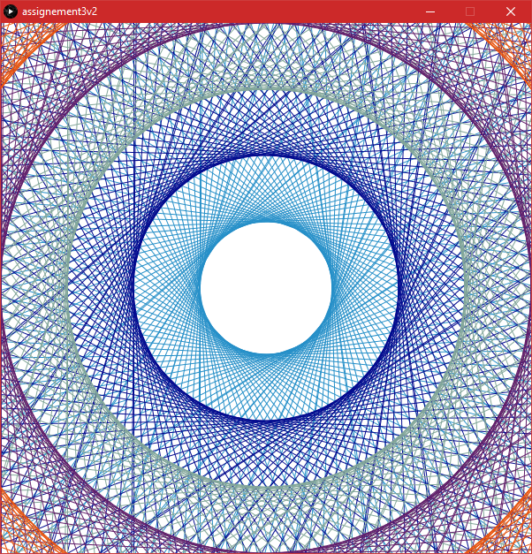
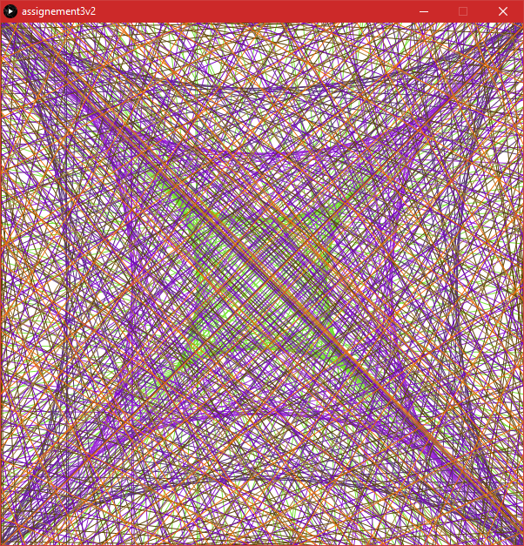
By Shape
Kevin M

Slide 9
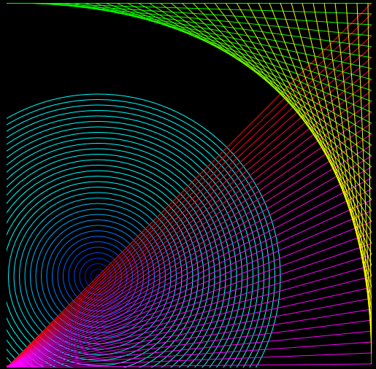
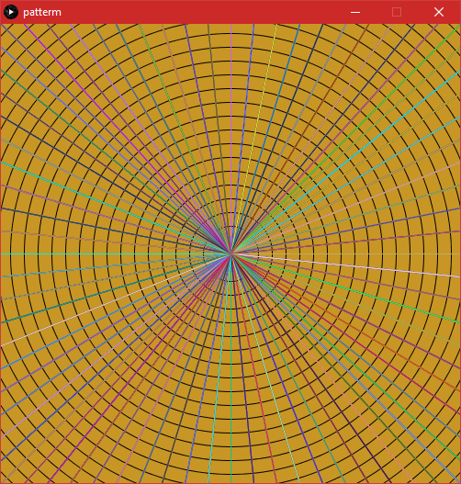
Contrast by shape, strokes, and color
Connor M
Jonari W

Slide 10
Textual distinction to improve readability and understanding
Monday Night Concert Series
Anthony Sharpe & Kathy Purcell
May 27 at 8 p.m.
Recital Hall, Simons Center, 54 St. Philip St.
$60 at the door
(843) 953.5927
Robert Ivey Ballet
The Velveteen Rabbit
June 2 – 4 at 6 p.m.
Sottile Theatre, 44 George .
$55 Reservations
(843) 556.1343
Geoffrey Porter
Jazzy Times
June 8at 7pm
$52 at the door
(843) 221.5996

Slide 11
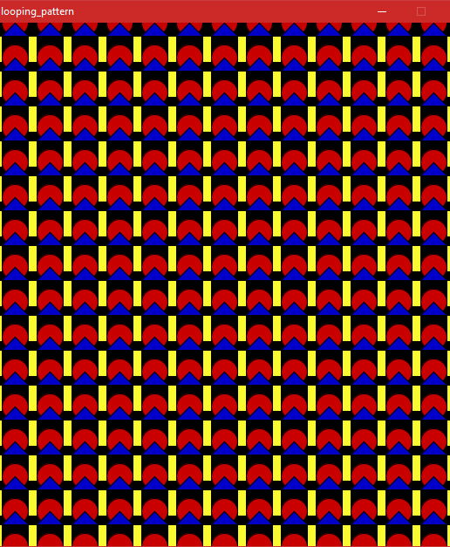
Your opinion…
What can be done to improve contrast?

Slide 12
Uses
The eye loves repetition but does not want to be bored. It likes familiarity but needs surprises.
~ Edith Bergstrom
Color
Shape
Texture
Spatial relationships
Line thicknesses
Sizes, etc.
… anything that makes the publication or design look cohesive and consistent.
Repeat visual elements of the design throughout the design.
Helps to develop organization and strengthens unity.

Slide 13
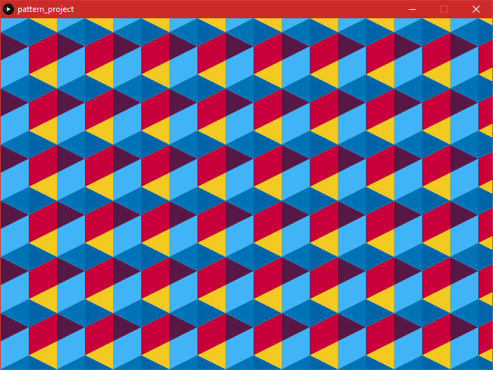
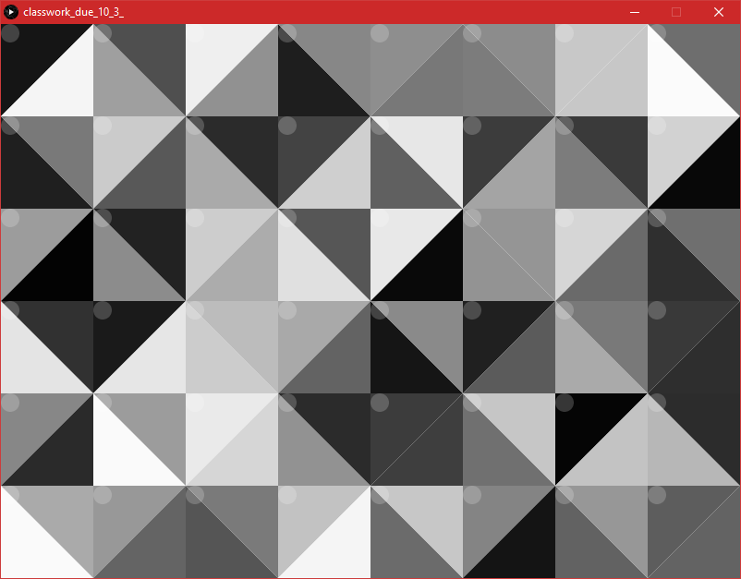
Amber M.
Jazmin B.
Beauty through repetition!

Slide 14
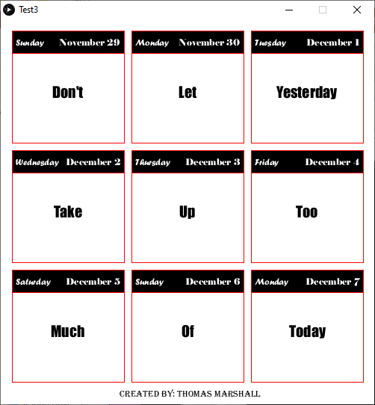
This is a motivational poster
Notes:
Repeating spots, while contrasting colors

Slide 15
Nothing should be placed on a page arbitrarily. Every element should have some visual connection with other element(s).
Uses
To create balance
To create visual connections
To create a grid system
To right, left, center or justify align

Slide 16
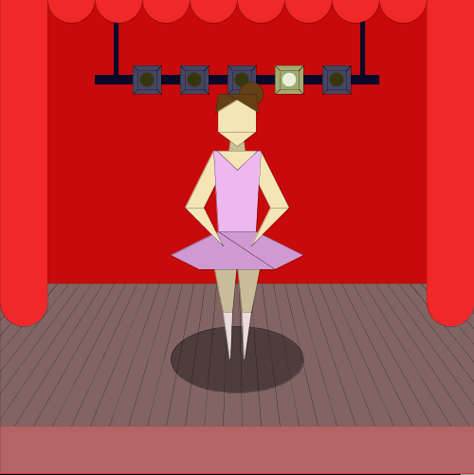
Example from Processing
F. Townsend

Slide 17
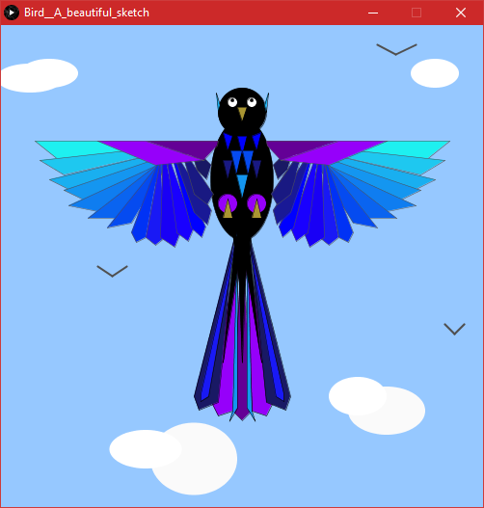
L. DuBreuil
More Processing: Flawless Alignment & symmetry

Slide 18
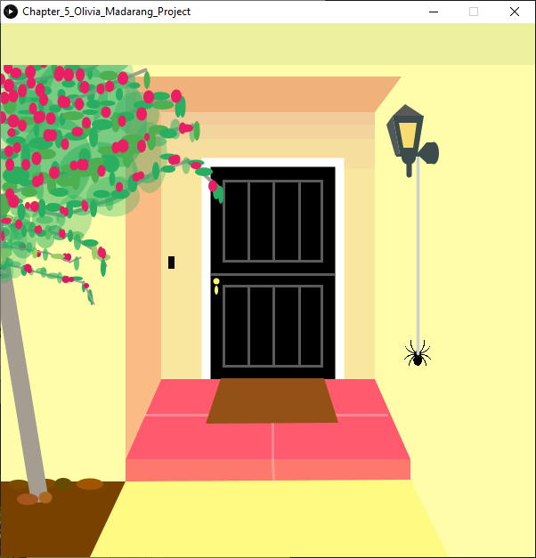
Does the leaning tree capture your attention more than if it were straight?
From a Processing textbook by Margaret Noble

Slide 19
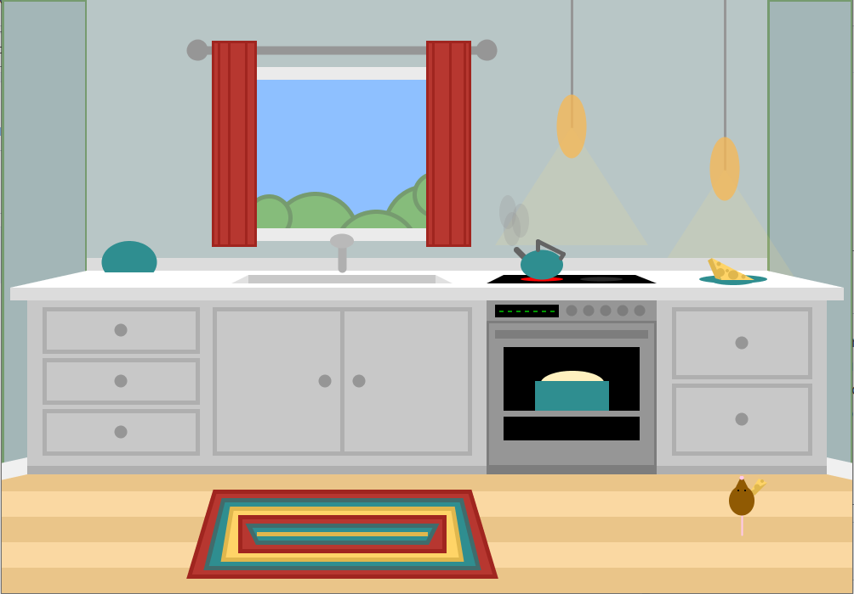
From a Processing textbook by Margaret Noble

Slide 20


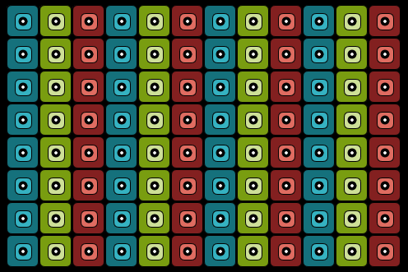

Center alignment does not have to be . . .
The Processing design is attractive, but what would you do to improve it?

Slide 21
Proximity gives visual clues as to what goes with what.
~Steven Bradley
Uses
To organize and reduce clutter
Bring together as a unit
Overlap items to connect them
Place text in proper position for easier reading.

Slide 22
Rachel S.
Example of Proximity with selection menu

Slide 23
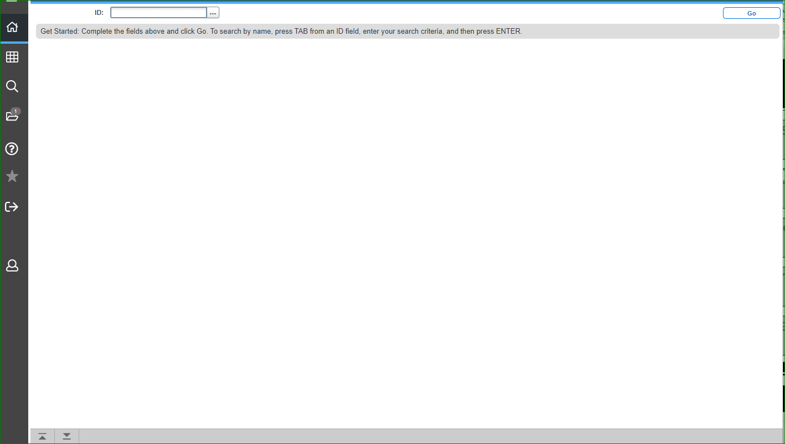
Really bad proximity!

Slide 24
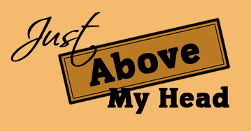


Overlapping can unify

Slide 25


The take-away…
Start applying these broad principles to your designs.

